Slide 1
Topic 1

Slide 2
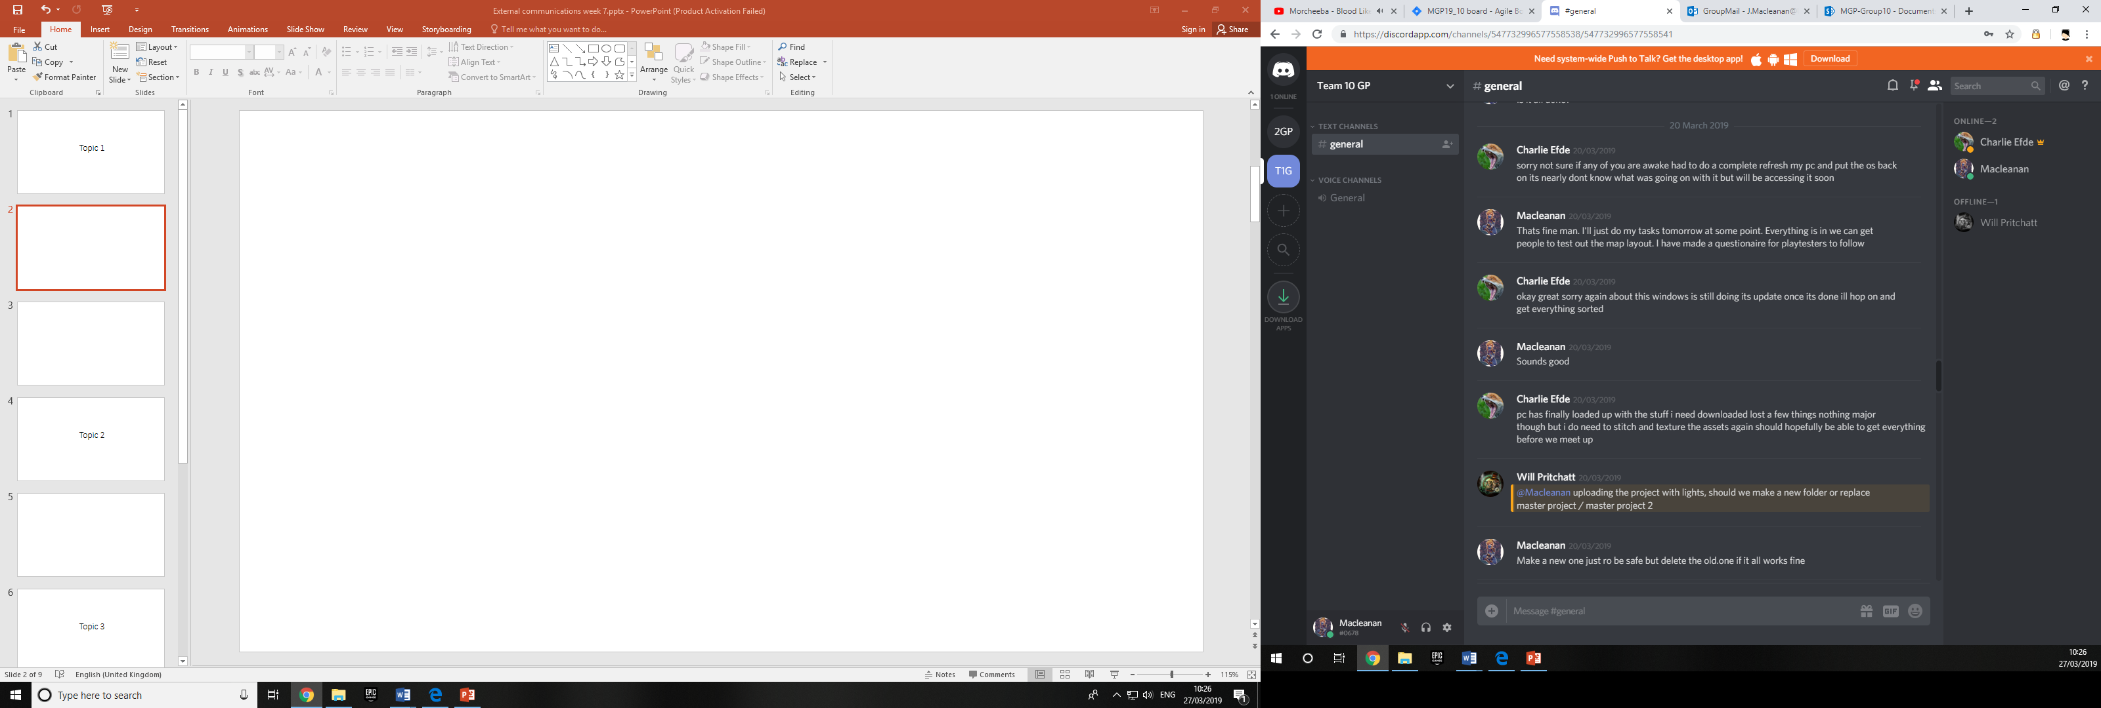

Slide 3
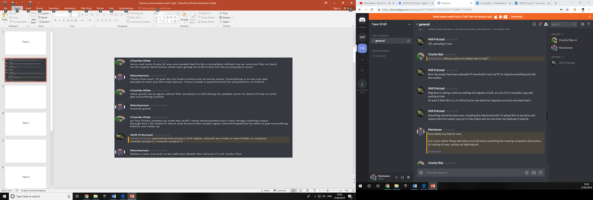

Slide 4
Topic 2

Slide 5
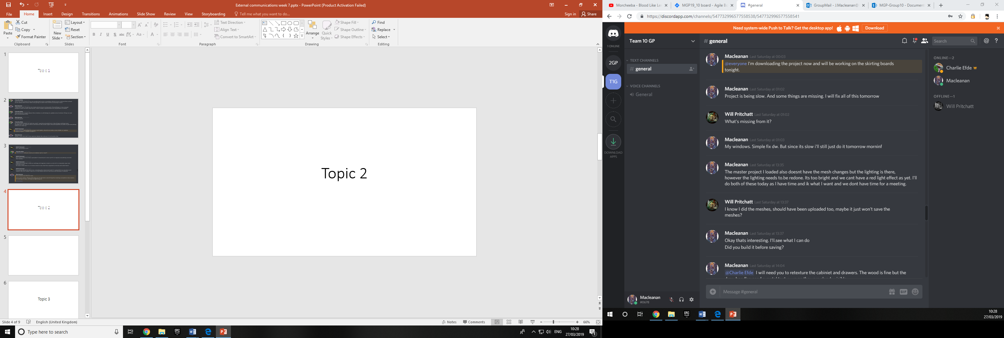

Slide 6
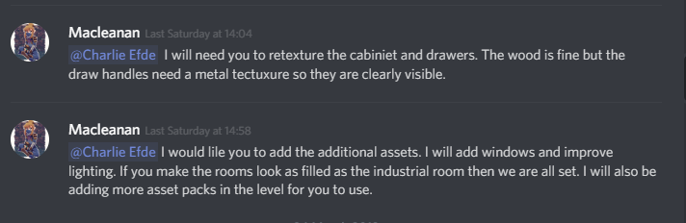

Slide 7
Topic 3

Slide 8
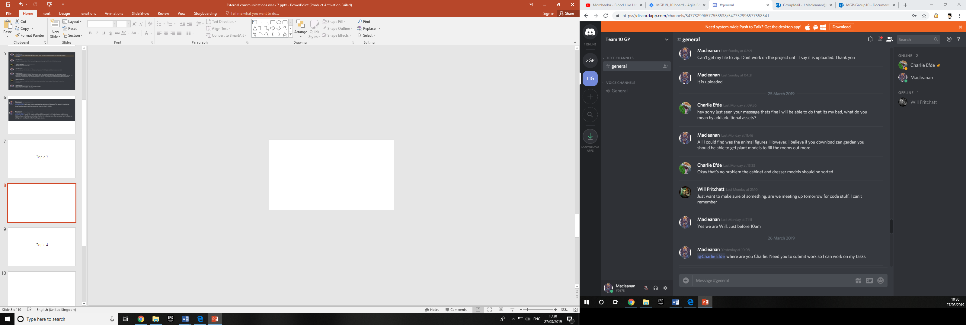

Slide 9
Topic 4

Slide 10
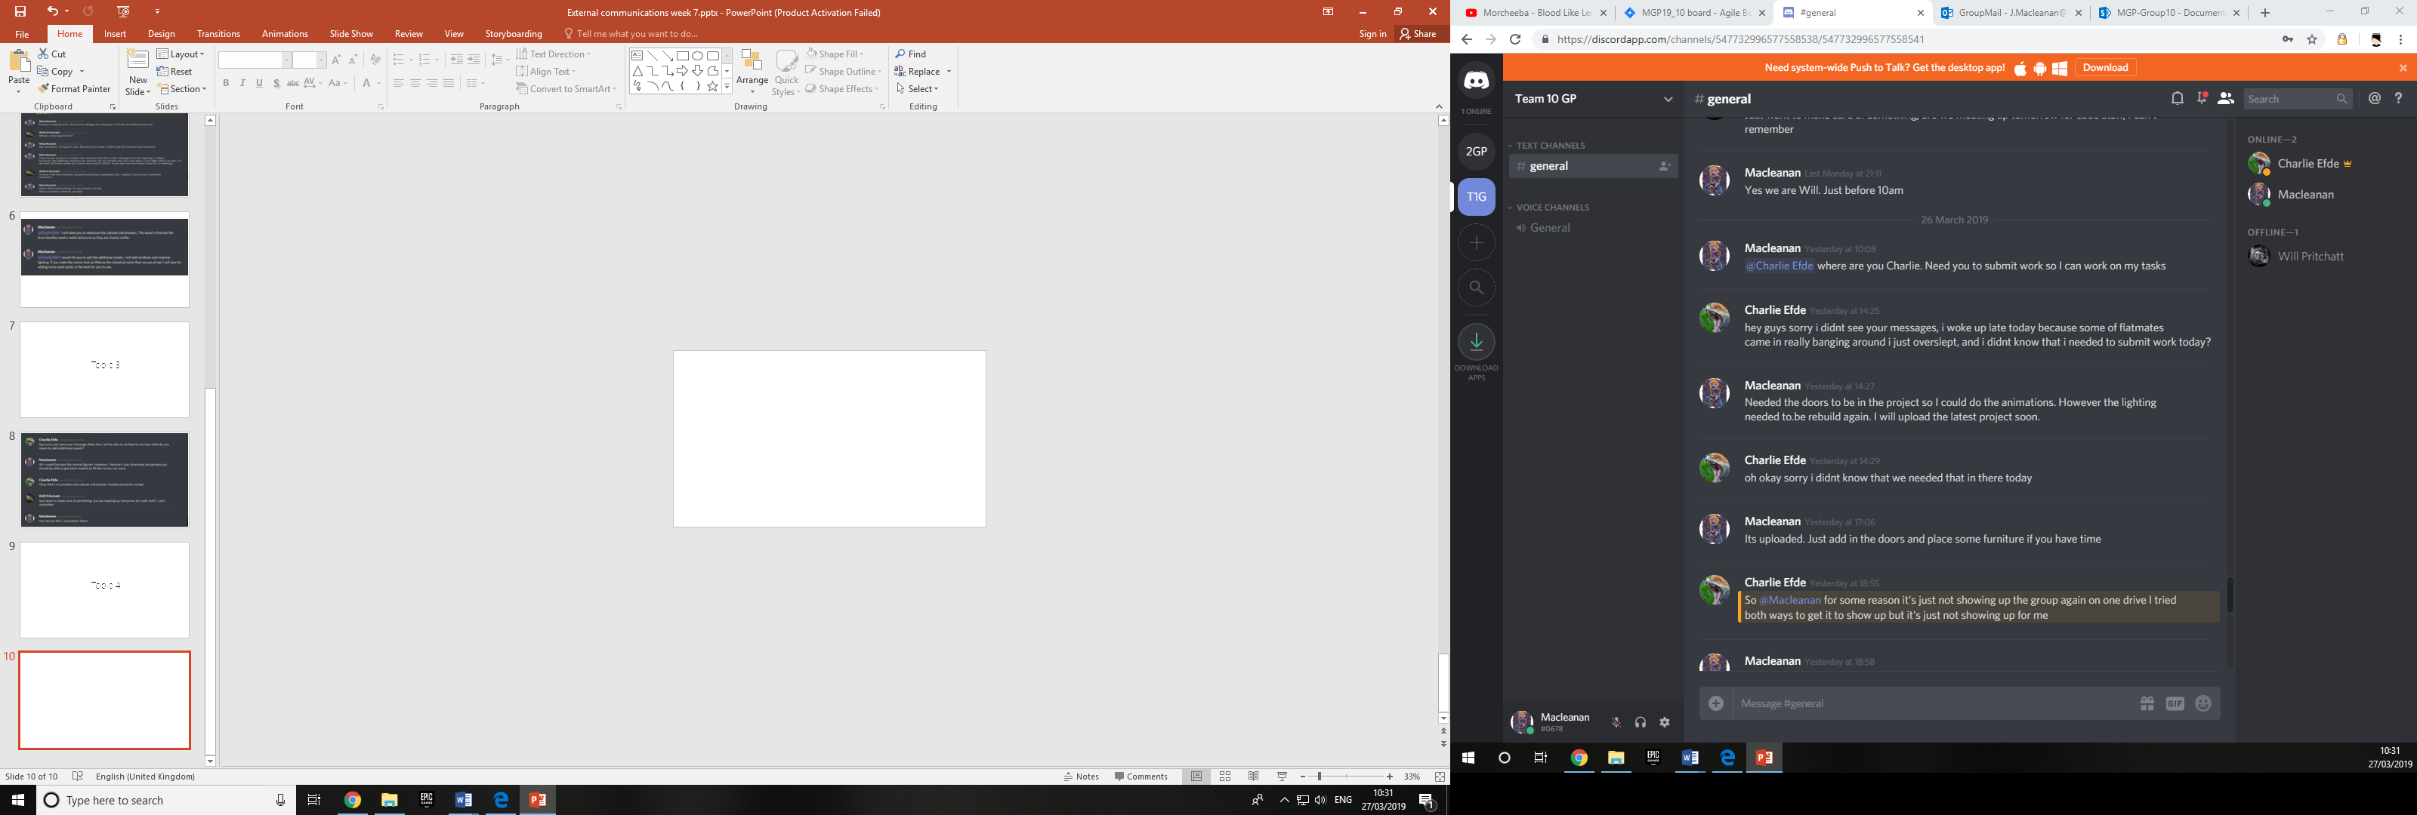
Messages made based on our planned meeting on Tuesday.

Slide 11
Topic 5

Slide 12
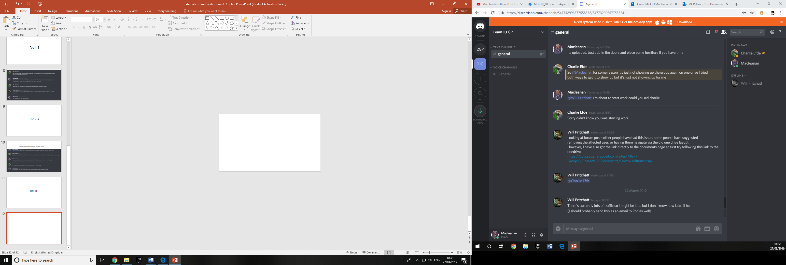

Slide 13
Topic 6

Slide 14
